Slide 1

CUSTOMER RETENTION
BY
K.Naveen Varma
BY
K. Naveen Varma

Slide 2
Introduction Of Project:
Customer retention is the ability of a company to retain its customers over a specified period. If a company has high customer retention, that means its customers continue to rebuy the same products, to resubscribe to the same services or, in some other way, continue buying from that company.
Customer retention is vital for two reasons: First, even if you are adding new business, you can’t grow your company if you are simultaneously losing business. The second reason is incredibly black and white: It’s always more expensive to acquire a new customer than it is to keep your current customers and sell more to them.
Customer satisfaction has emerged as one of the most important factors that guarantee the success of online store; it has been posited as a key stimulant of purchase, repurchase intentions and customer loyalty. A comprehensive review of the literature, theories and models have been carried out to propose the models for customer activation and customer retention. Five major factors that contributed to the success of an e-commerce store have been identified as: service quality, system quality, information quality, trust and net benefit.

Slide 3
Problem Statement:
You are required to model the which E-Commerce Retailer is most feasible with the available independent variables. This model will then be used by the management to understand how exactly the E-Commerce Retailer vary with the variables. They can accordingly manipulate the strategy of the firm and concentrate on areas that will yield high returns. Further, the model will be a good way for the management to understand.
For this dataset wants to know:
• Which variables are important to predict the variable?
• How do these variables describe which website is most friendly, feasible and reliable ?

Slide 4
Data Analysis:
The Dataset Contains a Data of 269 entries each having 71 variables, in which some are numerical Data and some are Categorical Data
Check the info of the data using the info() function
This is about Data set in which I changed the columns to make understandable and data set having one variable is integer remaining all are categorial values.
Next Step is EDA……..(Exploratory Data Analysis)

Slide 5
Exploratory Data Analysis:
In EDA we need to Pre-process the Data and Visualization:
Steps include in Pre-Processing Data are
1)Data Cleaning: - Removing Outliers, Skewness and imputing Missing Values.
2)Data Transformation: - like Normalization by applying normalization we can improve the accuracy and efficiency of the models. And also reduce the errors.
3)Data Reduction: By Reducing the no of features by Feature Selection Process, PCA And VIF
1.Data Cleaning: As a Part of EDA we need to do Data cleaning so firstly we need to check any null values in our data, From the below image shows we don’t have any null values, so no need to impute any data

Slide 6
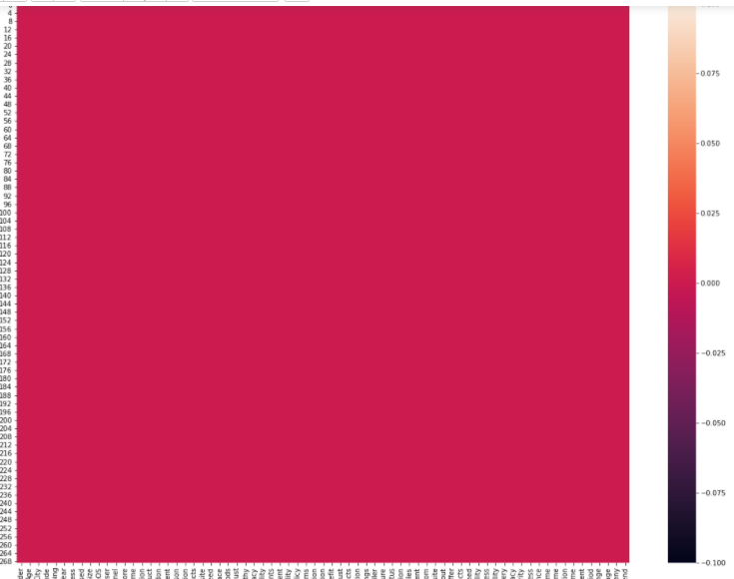
First Step of Data Cleaning is Checking Any null Values in our Data set
For this we used the function

Slide 7
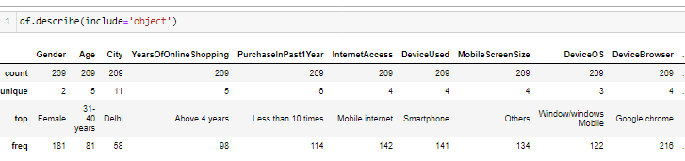
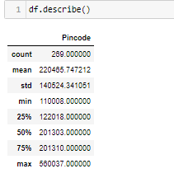
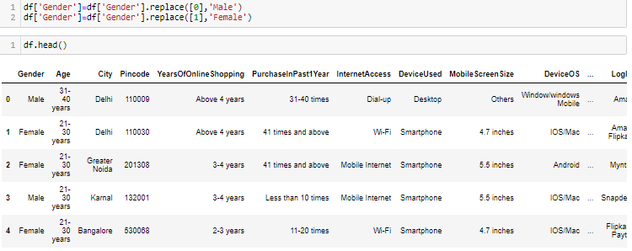

Slide 8
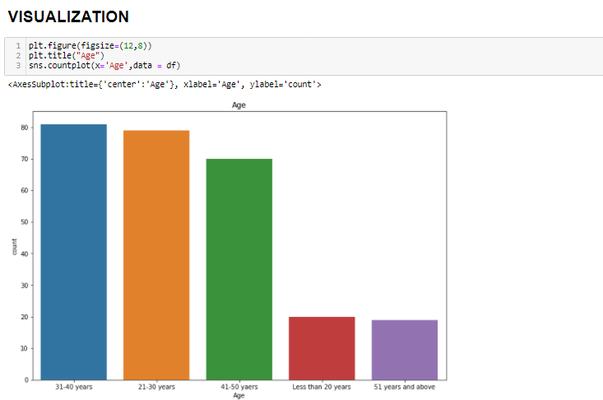
Visualisation:
We Analyze the variables using the countplot for categorical the variables and distplot for numerical variables
Here in Gender category Females are more than 175 than Male are in between 75 to 100

Slide 9
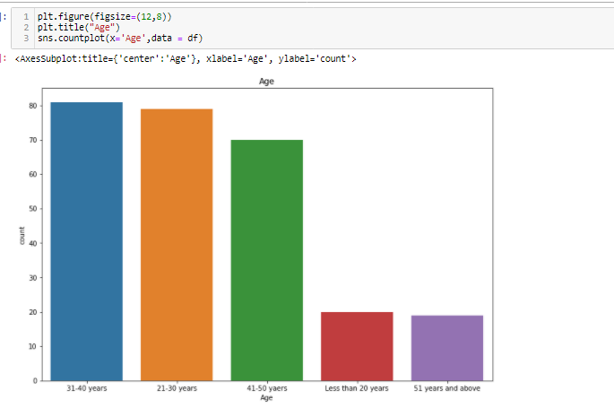
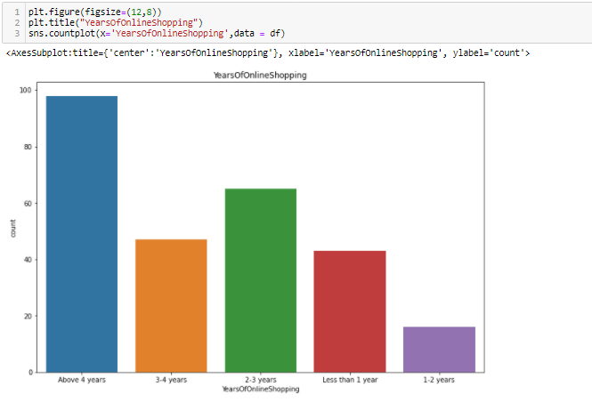
Observations:
From the plots we can clearly see that most of the respondents fall into the following three categories:-
31-40 years
21-30 years
41-50 years
Very few respondents fall into the categories :-
Less than 20 years
51 years and above.
Observations:
Here some E-commerce site having an experience of Above 4 years are in between 80-100.
Some other having 3-4 years in between 40-60.
Other having 2-3 years are in between 60-80.

Slide 10
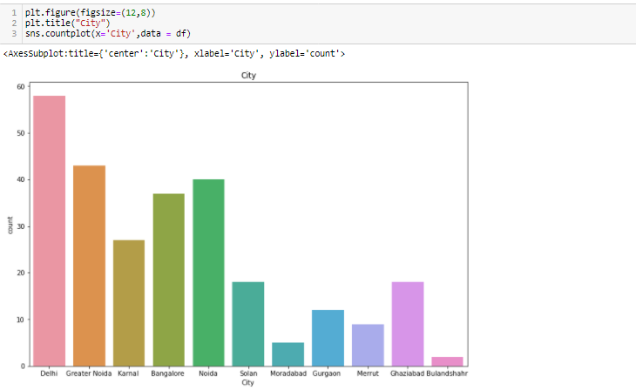
Observations:
we can see a very large no.of people shopping from Delhi city i.e in between 50 to 60.
Similarly people from Greater Noida shopping in between 40 to 50.
Similarly people from Kamal shopping in between 20 to 30.
Similarly people from Banglaore shopping in between 30 to 40.
Similarly people from Noida shopping almost 40.
Similarly people from Solan city, Gurgaon, Ghaziabad shopping in between 10 to 20.
Similarly people from Moradabad, Bulandshahr shopping in between 0 to 10.

Slide 11
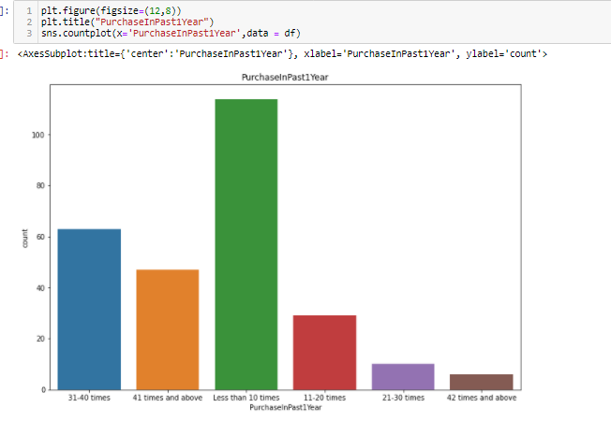
Observations:
The people in blue code above 60 in numbers are purchased the item 31-40 times in past 1 year.
The people in orange code in between 40-60 in numbers are purchased the item 41 times in past 1 year.
The people in green code above 100 in numbers are purchased the item less than 10 times in past 1 year.
The people in red code in between 20-40 in numbers are purchased the item 11-20 times in past 1 year.
The people in violet code in between 0-20 in numbers are purchased the item 21-30 times in past 1 year.
The people in brown code in between 0-20 in numbers are purchased the item 42 times in past 1 year.

Slide 12
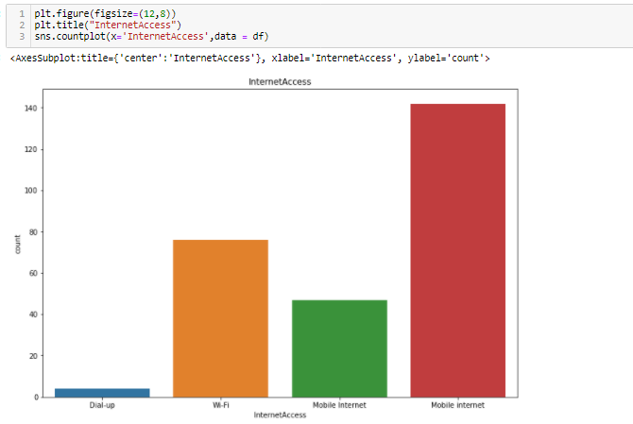
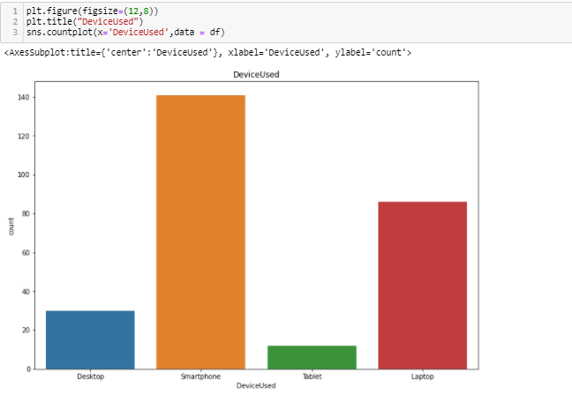
Observations:
Its clear that most of people were using/Depends up on Mobile Internet rather than Wifi or Dial-up for online shopping.
Observations:
Smart phones are more popular devices used by public and then next is Laptop then Desktop & Tablet.

Slide 13
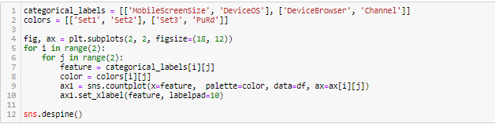
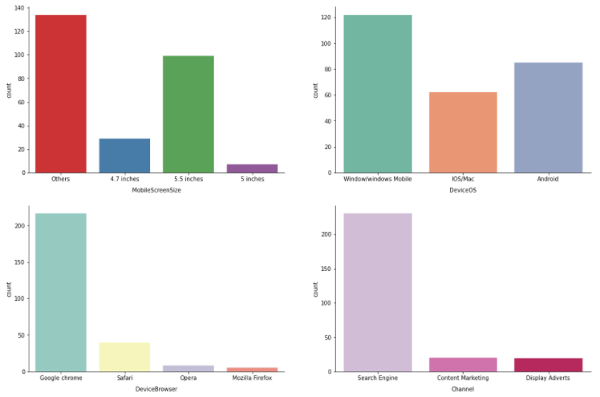
MOBILE SCREEN SIZE:
The data which we have it is saying most people have screen size apart from 4.7,5.5,5 inches. to that most people have 5.5 inches of screensize of the mobile.
Observations:
DEVICE(OS):
Most commonly used operating system is Windows and next followed by Android and then next ios/Mac.
Device Browser:
Google Chrome is most used browser than safari, opera and Mozilla Firefox.
Channel:
Seach Engine is the most used tool than Content Marketing & Display Adverts.

Slide 14
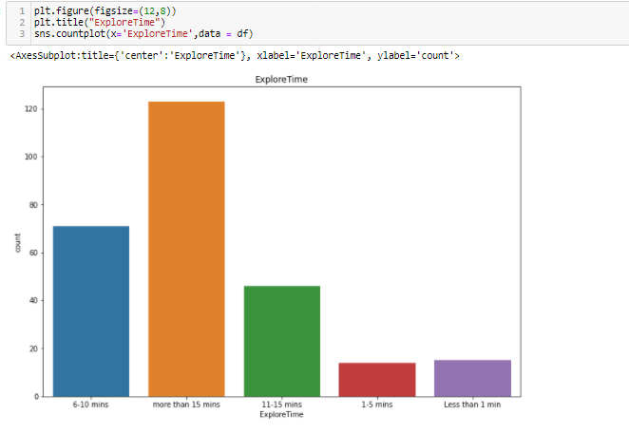
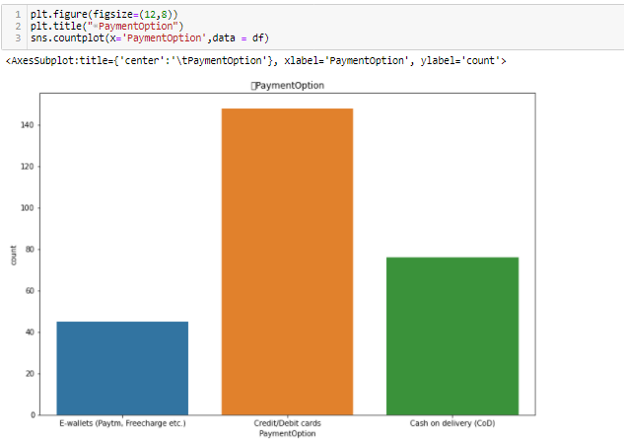
Observation Mostly people are engaging to explore more than 15 minutes
Observations:
Public used Credit/Debit Cards while shopping. Then by Cash on Deleivey(COD) and then E-wallets

Slide 15
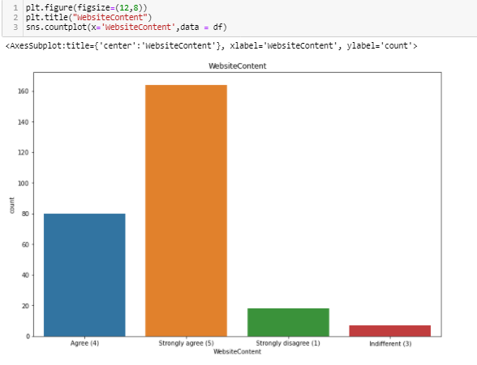
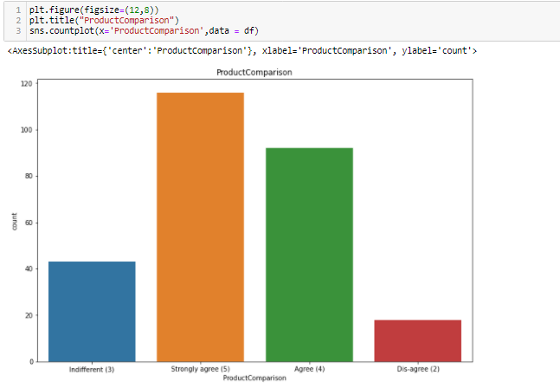
Observations:
Mostly people strongly agree that "WebsiteContent" is very much important.
Very less people dis-agree with "WebsiteContent" is very much important.
Observations:
Most people thinks Product comparision is very much need. For getting the better product

Slide 16
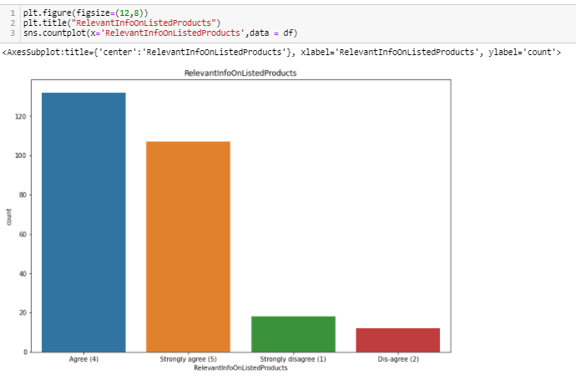
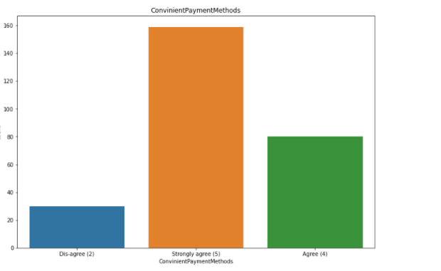
Observations
Most people will show intrest on the information about the product if they want to buy. So, there are above 120 in number of people who are agree for this
Observations:
Most people will stongly agree for purchasing the items in simple way

Slide 17
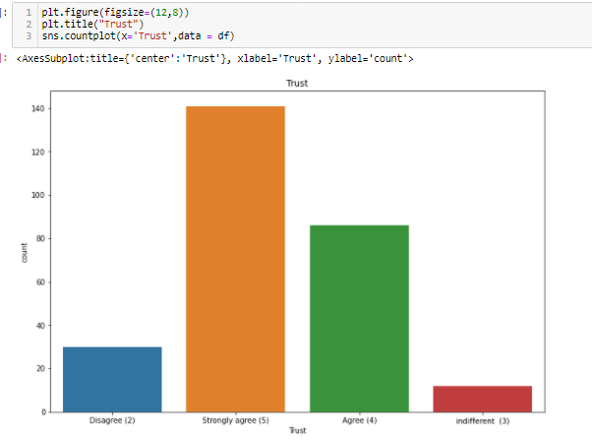

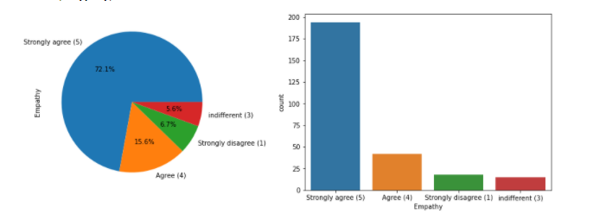
Trust is the most important thing in business it plays very crucial role. So in this Obviously all people will strongly agree while purchasing an item
Observations:
Most of Customers firmly believe that approach of "Empathy" is the most important concern.
So here 72.1% are stongly agree to this comparing to others.
As i used pie chart here for better representation than the count plot.

Slide 18

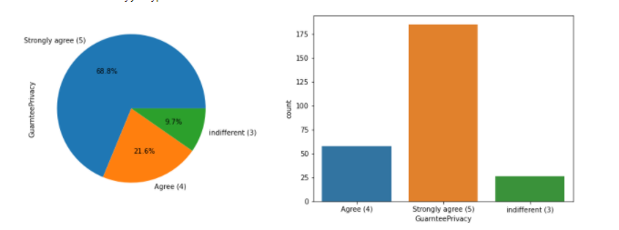

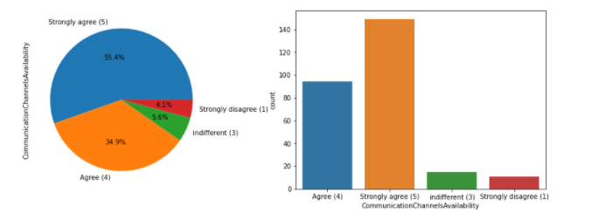
Observations:
As we all know that privacy is the most vital thing as all the customers data like credit-card number, debit-card number, are stored in the retailers database, and customer believes on the company that it will not breach the private data policy.
Our records also shows that most of customers strongly beleive that online store must guarantee the privacy of the data of customers
Observations:
Most of the customers expect that their online store must provide the assistance to them through various modes like ("Email","Text messages","Phone Call").

Slide 19

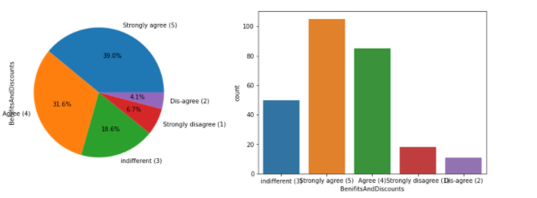

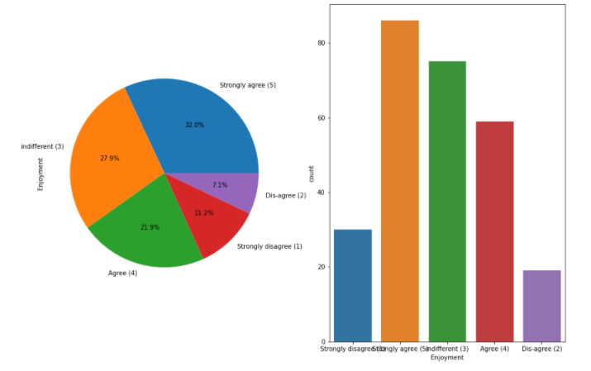
Observations:
Mostly of the customers are inclined towards the perks of monetary benefits while shopping in the forms of coupons,discount offers etc
Observations:
Most people agree that they enjoy the online shopping.
Many of respondents are also unconcerned about the enjoyment.
Very few of them disagree with the fact of enjoyment while online shopping.

Slide 20


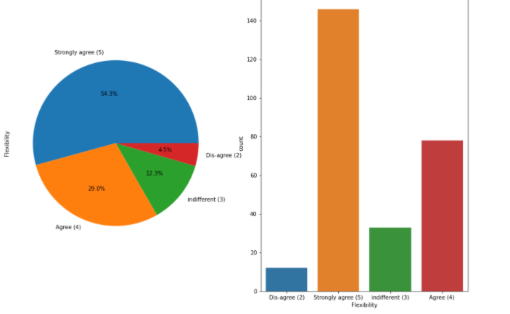
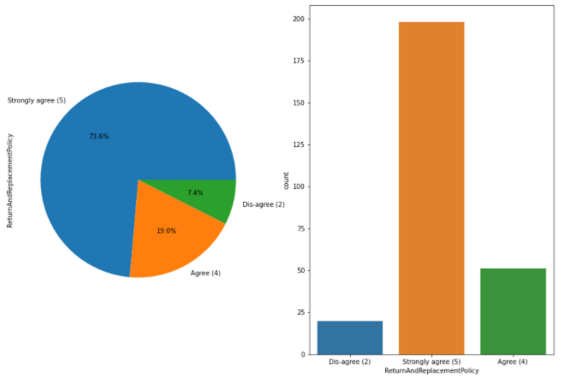
Observations:
As we all know that Return and Replacement policy is very much important for a customer since if the product which he/she buyed didnt performing well then they can return it to the seller without any problem by giving proper reason of return of product.
Most of the customers are agreeing with the fact that there must be customer friendly return or replacement policy must be present in the company.

Slide 21
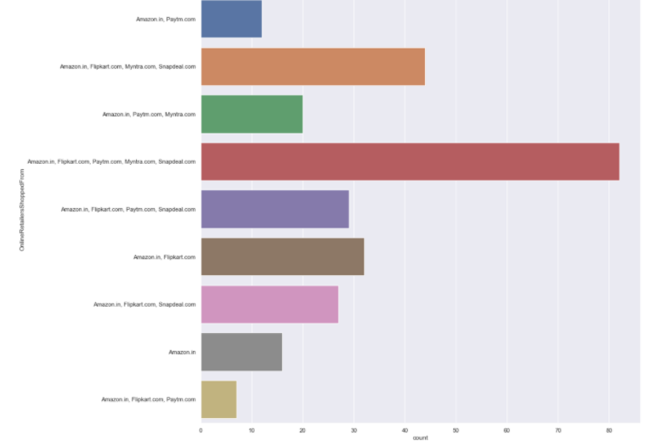
We can see that mostly people are recommending "Amazon.com" & "Flipkart.com" to others.
Least were recommended website is "Paytm" & "Snapdeal"

Slide 22
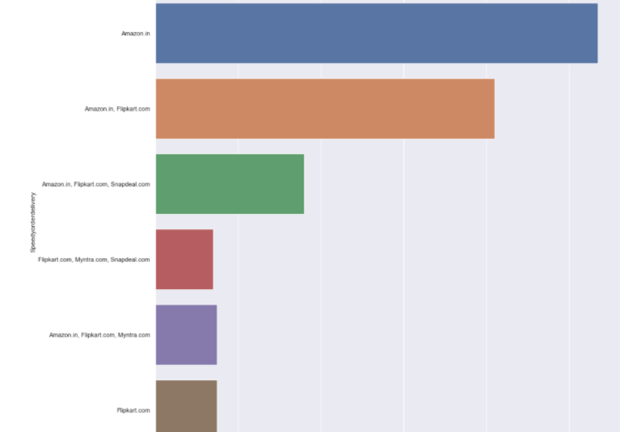
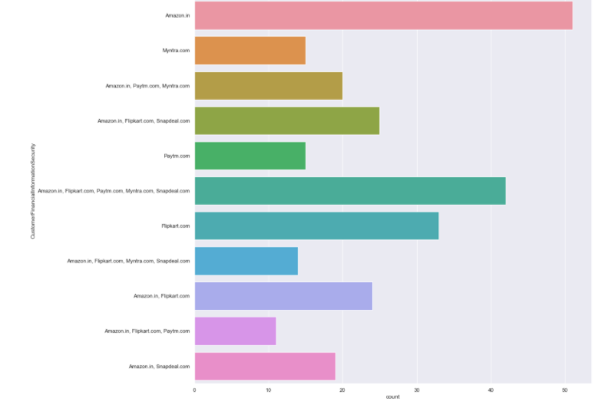
Amazon is delevering in quick way than others
For observing above graph analyze that Amazon leads the e-commerce industry with lot of offers and user friendly

Slide 23
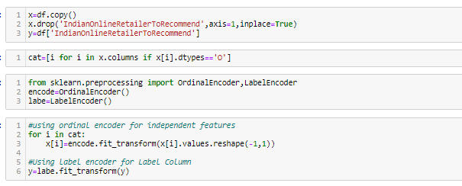
Label Encoding:
Label Encoding is necessary for the data to process to find any outliers are there as of our data consists of both numerical and categorical need to change categorical into numerical values using the encoding methods.
One Hot Encoding:
Categorical data refers to variables that are made up of label values, for example, a “color” variable could have the values “red“, “blue, and “green”. Think of values like different categories that sometimes have a natural ordering to them.

Slide 24

Skewness of Data:
As of our numeric data is skewed we need to do normalization before go for training and testing for that need to check the skewness of data if our data is Greater than 0.5% in both positive and negative sides ,then need to do power transformation and do scaling
Scaling are of two types:
1.Standard Scaler: Standard scalar standardizes features of the data set by scaling to unit variance and removing the mean (optionally) using column summary statistics on the samples in the training set.
MIN-MAX Scaler: MinMaxScaler. For each value in a feature, MinMaxScaler subtracts the minimum value in the feature and then divides by the range. The range is the difference between the original maximum and original minimum. MinMaxScaler preserves the shape of the original distribution.

Slide 25
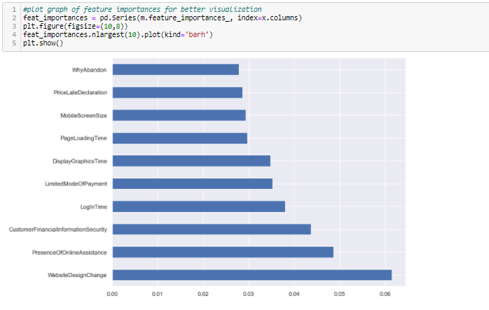
Observations:
In the above chart we can see that above features are of most importance in determining which platform will a customer recommend to his friend

Slide 26
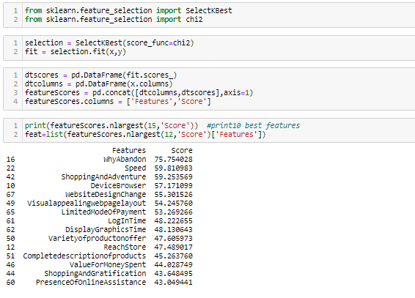
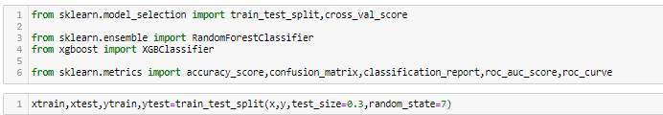
Splitting Data Into train_test_split: -
This function is in sklearn. Model selection splitting the data array into two arrays. Train and Test with this function we don’t need to splitting train and test manually.by default it make random partition and we can also set the random state.it gives four o/p like x_train, x_test, y_train, y_test.
As we do splitting the data for training and testing the data then now we need to modeling
Try Different Models….

Slide 27
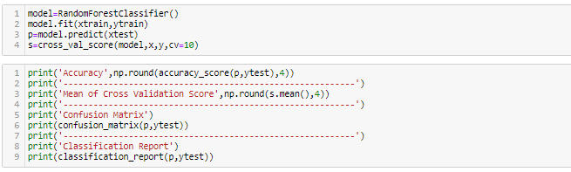
Random Forest Classifier: Random forest is a supervised learning algorithm. The "forest" it builds, is an ensemble of decision trees, usually trained with the “bagging” method. The general idea of the bagging method is that a combination of learning models increases the overall result.
Random forest has nearly the same hyperparameters as a decision tree or a bagging classifier. Fortunately, there's no need to combine a decision tree with a bagging classifier because you can easily use the classifier-class of random forest. With random forest, you can also deal with regression tasks by using the algorithm's .
Now lets see about each one in our output clearly:
Confusion Matrix: It is the table that is used to describe the performance of classification model on set of tests data.by using different parameters.

Slide 29
Now lets understand the Recall Precision and f1-score
Accuracy: it can be defined as the ratio of total number of correct classifications divided by total number of classifications.
Accuracy=(TP+TN)/(TP+FP+TN+FN)
Precision: It is measure of all the positive predictions how many of them actually positive. Precision=TP/(TP+FP)
F1-Score: It give the combine result of Recall and Precision
F1-score=2*(Precision*Recall)/ (Precision + Recall)
ROC-AUC Curve:- It is the performance measurement of the model at diff diff thresholds. ROC is the performance score and AUC is the separation score means how much mode classify 0 as 0 and 1 as 1.

Slide 30
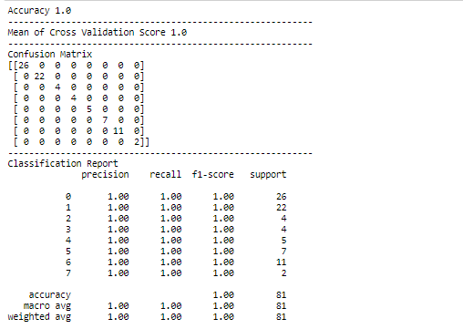
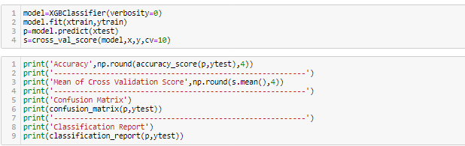
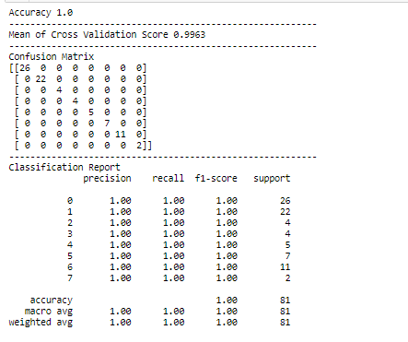
XGBoost Classifier:
XGBoost is an algorithm that has recently been dominating applied machine learning and Kaggle competitions for structured or tabular data. XGBoost is an implementation of gradient boosted decision trees designed for speed and performance

Slide 31
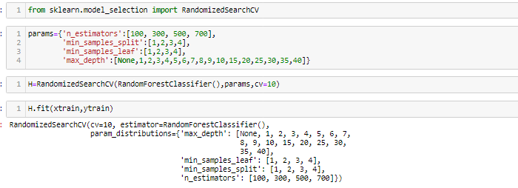
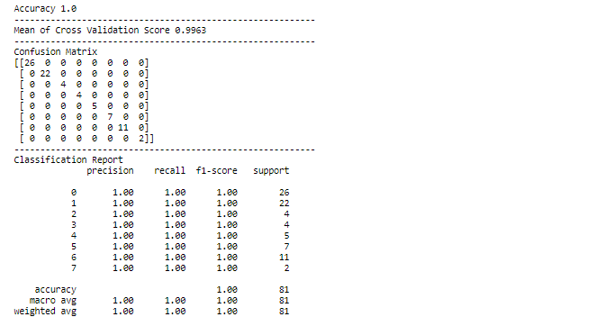
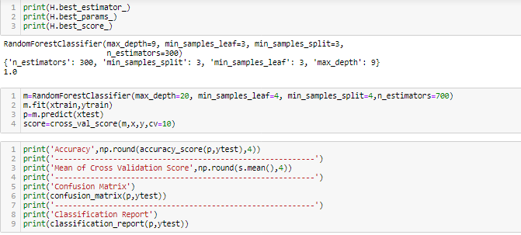

Slide 32
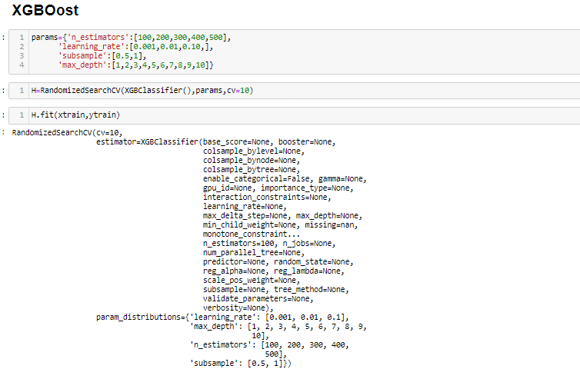
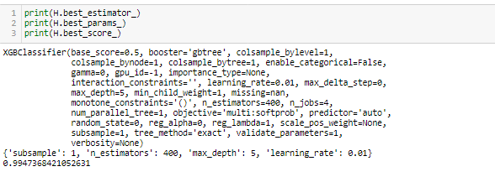

Slide 33
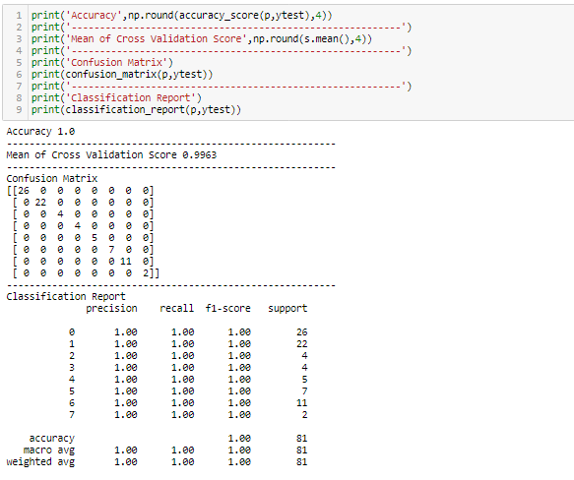
Conclusion:
The cost of the product, the reliability of the E-commerce company and the return policies all play an equally important role in deciding the buying behaviour of online customers. The cost is an important factor as it was the basic criteria used by online retailers to attract customers. The reliability of the E-commerce company is also important, as it is even required in offline retail. It

Slide 34

is important because customers are paying online, so they need to be sure of security of the online transaction. The return policies are important because in online retail customer does not get to feel the product. Thus, he wants to be sure that it will be possible to return the product if he does not like it in real. Whereas, the logistics factor, which included Cash on delivery option, One day delivery and the quality of packaging plays a secondary role in this process though these are Must-be-quality. This is so because these all does not interfere with the real product and people believe that this is the basic value that E-commerce websites provide.
All the websites were not equally preferred by online customers. Amazon was the most preferred followed by Flipkart. This can be explained easily by previous result that we got. These two companies are most trusted in the industry and hence, have a huge reliability. Also, the sellers listed on these websites are generally from Tier 1 cities as compared to Snapdeal and PayTM which have more sellers from tier 2 and 3 cities. Also, these websites have the most lenient return policies as compared to others and also the time required to process a return is low for these

Slide 35


